Slide 1

Final Project Identify Tree Species from Leaf Images
Trias, Fernando
CSCI E-89 Deep Learning
Harvard University Extension School
Prof. Zoran B. Djordjević

Slide 2
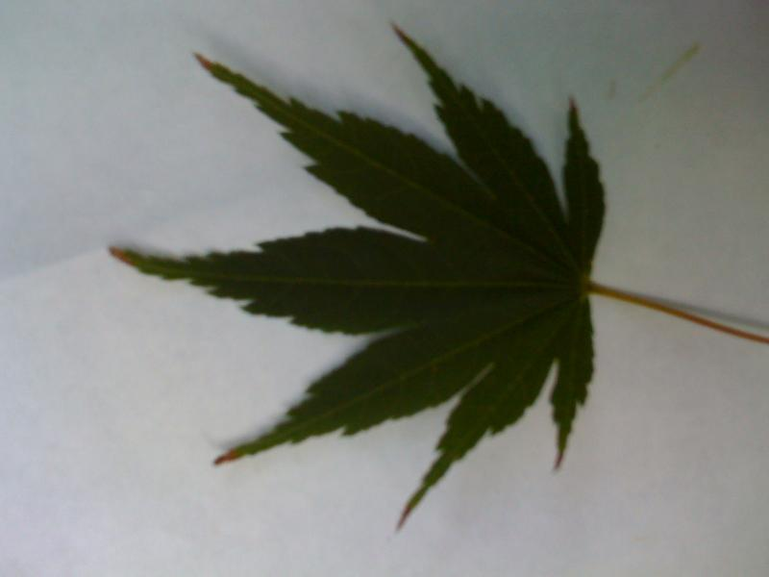
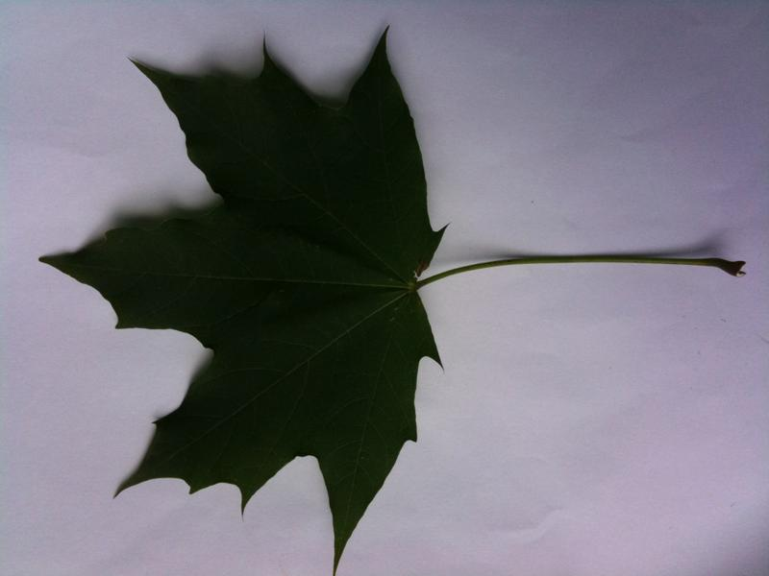
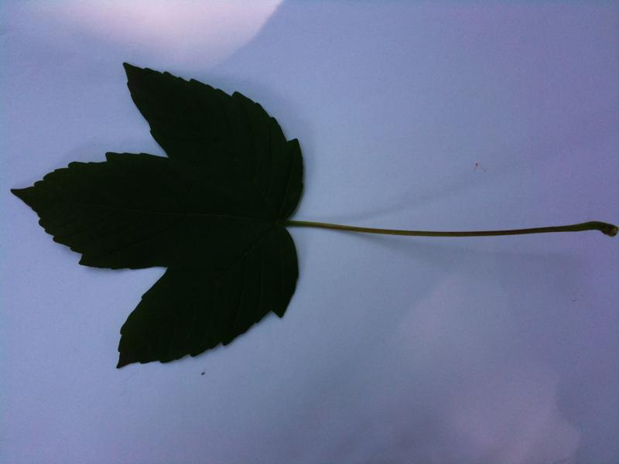
Introduction
For broad-leaf trees, it is often (but not always) possible for an expert to identify the species of tree by merely observing the leaves. However, it is difficult for non-experts to do so.
Computers generally have had unsatisfactory results. Many existing systems use image processing to identify properties of the leaves, like branching patterns, points and shape, and then traverse a decision tree, but this method is unreliable.
I wanted to investigate if a convolutional neural network could identify the species of a tree by only looking at an image of a leaf.
Acer palmatum
“Japanese maple”
Acer platanoides
“Norway maple”
Acer pseudoplatanus
“Sycamore”

Slide 3
Dataset
Leafsnap is a collaboration by researchers from Columbia University, the University of Maryland, and the Smithsonian Institution.
They provide an App that identifies Northeastern trees from an image of a leaf. Their App uses image processing to identify features and then identify a species using a decision tree.
In addition, they provide all the raw data used to test their system at http://leafsnap.com/static/dataset/leafsnap-dataset.tar. This data is 976 MB. However, after removing pine trees and other non-broadleaf trees, the images are 334 MB.
Software & Hardware
Amazon Linux (p2.xlarge)
Keras
Tensorflow
OpenCV

Slide 4
Cleaning and Preprocessing
Only consider trees in the Northeastern US for which the data is of high quality
Removing non-broadleaf trees (pine trees, spruces, etc) leaves this data.
26603 images
159 tree species
Converting to grayscale
Although the color of the leaf is helpful in identifying a tree, the images are not taken under consistent lighting and thus the colors are not very accurate.
Analyzing grayscale will speed up training.
Resolution of 224x224
Features such as veins and leaf edges are small and so the image must be large enough to maintain some of these features.
When scaling images, aspect ratio must be maintained because overall shape is important. Thus, a custom scaling function is employed.
Augmentation
Rotation, width/height shifts, zoom and small shear

Slide 5
Train, Validation and Testing
Data split into three non-overlapping groups: Train, Validation and Testing. Each group must have several samples of each tree species.
Group | Images | Percent
Training | 21285 | 80%
Validation | 2661 | 10%
Testing | 2657 | 10%
Training set will be used to train the neural network
Validation set will be used during the training for validation at the end of each epoch.
Testing will be used after the model has been trained to evaluate and compare with other models.

Slide 6
Models Tried
MobileNet
Provided by Keras
Trained for 100 epochs
SGD optimizer
Learning rate 0.01
Momentum 0.9
Decay 0.001/50
2.5 hours run time
Convolutional
3 Convolutional layers
Trained for 300 epochs
SGD optimizer
Learning rate 0.01
Momentum 0.9
Decay 0.001/50
16.5 hours run time

Slide 7
Comparison
Evaluating the model over the Testing set shows that MobileNet is superior and that the validation accuracy is a good proxy for the model’s results.
Errors in identification were often due to bad quality of the original image, or images that failed to capture distinguishing features.
 | MobileNet | CNN
Trainable parameters | 3,369,375 | 13,225,119
Epochs | 100 | 300
Training accuracy | 0.9814 | 0.9016
Validation accuracy | 0.9248 | 0.8290
Test accuracy | 0.90625 | 0.8438
Training time | 2.52 hours | 16.47 hours

Slide 8
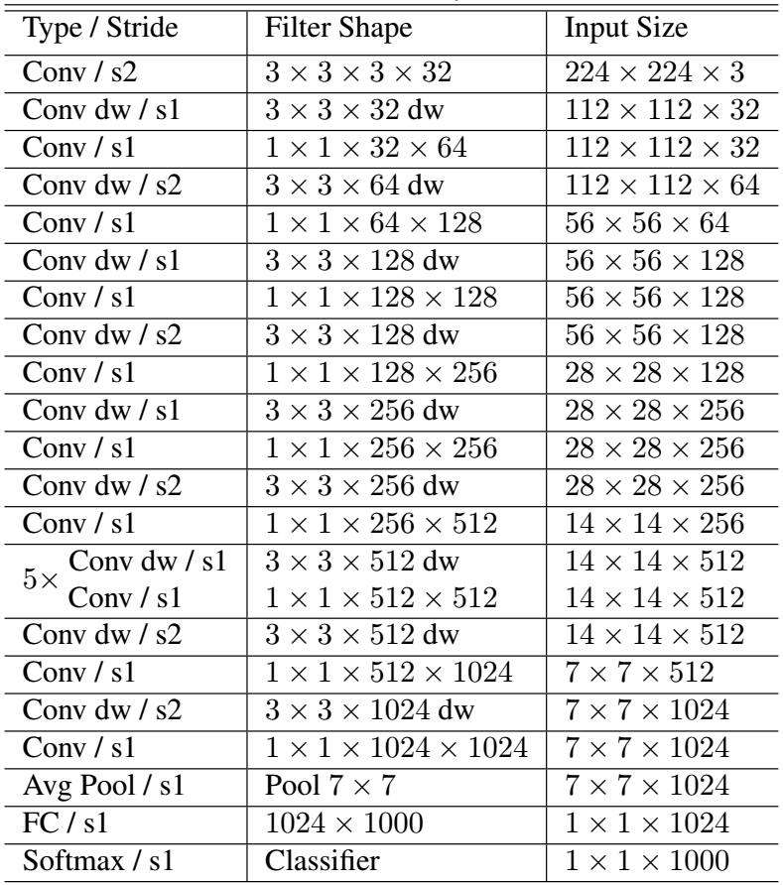
MobileNet
Similar to ResNet and Inception
Optimized for slow processors and limited memory
Can also run without floating point calculations
Supported by Tensorflow Lite and CoreML so it is easier to create mobile app.

Slide 9
Examples
Actual | Top prediciton | 2nd prediction | 3rd prediction
ilex_opaca | 0.99916005 ilex_opaca | 0.00051971286 ostrya_virginiana | 0.00011364489 platanus_occidentalis
populus_grandidentata | 0.99978584 populus_grandidentata | 0.00012750519 crataegus_pruinosa | 3.2079985e-05 populus_deltoides

Slide 10
Certainty
As shown below, when prediction is correct, certainty is very high.
When prediction is wrong, certainty is mixed.
This is because some leaves are indistinguishable. For example, see prediction for Ostoya virginiana below.
Fagus grandifolia and Ostrya virginiana have virtually identical leaf images.
But trees have very different size, shape and bark.

Slide 11
YouTube URLs, Last Page
Two minute (short): https://youtu.be/S6jOuE9KHlg
15 minutes (long): https://youtu.be/TKbMa8bZzLQ
References
“Leafsnap: A Computer Vision System for Automatic Plant Species Identification,” N Kumar, P Belhumeur, A Biswas, D Jacobs, W Kress, I Lopez, J Soares, Proceedings of the 12th European Conference on Computer Vision (ECCV), October 2012.
“Plant leaf recognition using shape features and colour histogram with k-nearest neighbor classifier,” T Munisami, M Ramsurn, S Kishnah, S Pudaruth, Second International Symposium on Computer Vision and the the Internet, 2015.
“Leaves recognition system using a neural network,” B Sekeroglu, Y Inan, 12th International Conference on Application of Fuzzy Systems and Soft Computing, August 2016.
“Deep Residual Learning for Image Recognition,” Kaiming He, Xiangyu Zhang, Shaoqing Ren, Jian Sun, 2015.

